Slide 1

Transaction Analysis to Drive Fraud Detection
Ron & Inessa
May 2025

Slide 2
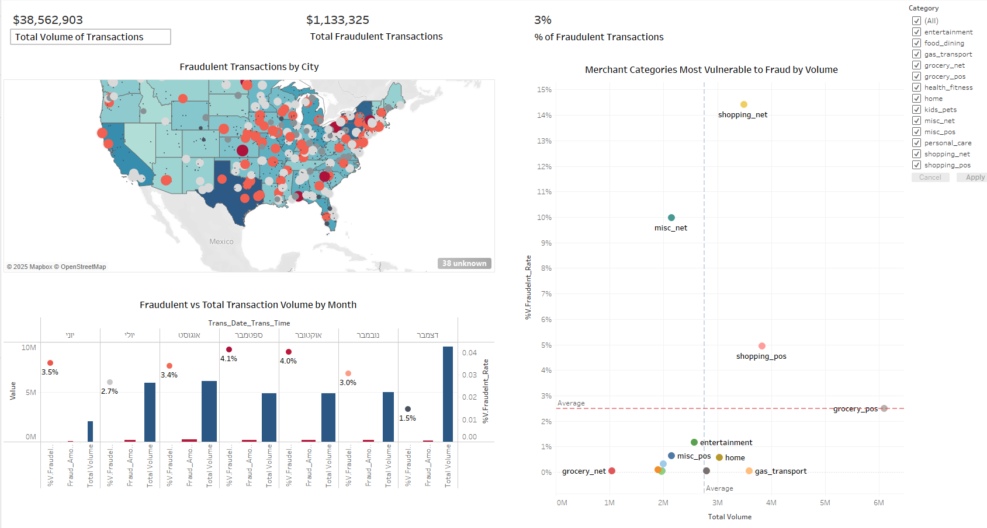
Tableau Dashboard

Slide 3


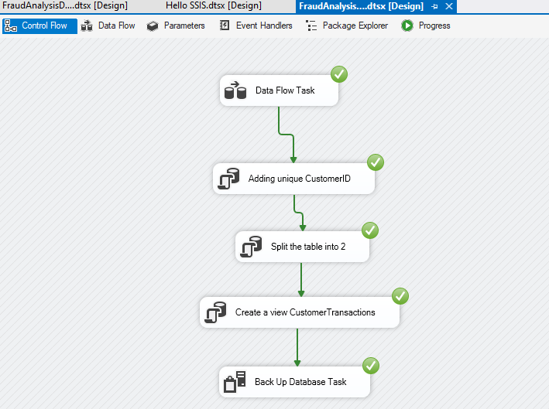
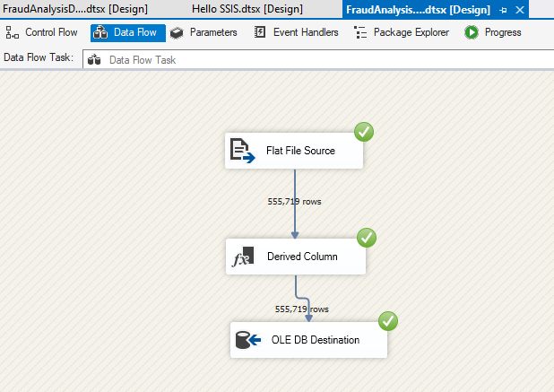

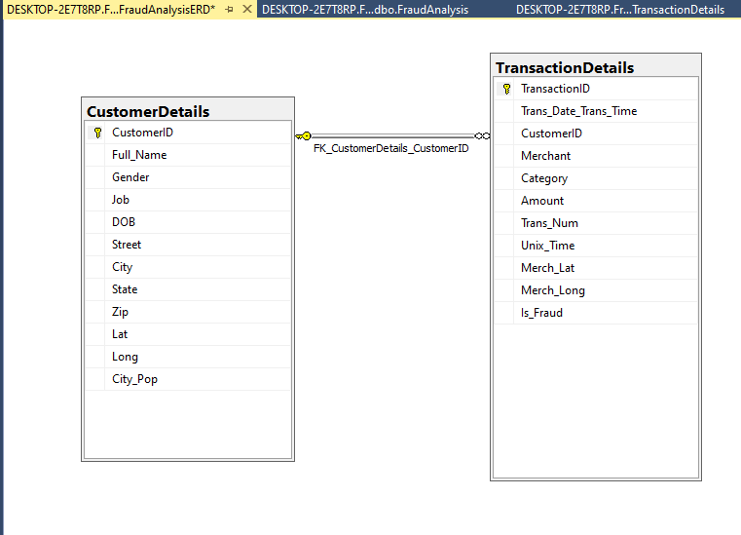
Dataset Overview
Creating DW via SSIS
The dataset contains transaction records with key
information such as:
917 Customers: ID, name, gender, job
693 Merchants: Categories, Geo location
555,719 Transactions: (Amount, date/time)
Fraud status (Is_fraud?)
ERD
The Database was downloaded from Kaggle - link

Slide 4

Fraudulent vs Total Transaction Volume by Month
Key Insights:
Fraudulent transaction amounts peak in August at $208,785 USD
Fraudulent Amounts show noticeable variation across months suggesting special offers, changing in customer behavior and seasonal fraud.
Next Steps:
Investigate potential causes for higher fraud in mid-year months.
Notes:
Consider monitoring fraud indicators more closely in periods of high transaction volume but relatively low fraudulent rate (like December) to ensure that any fraud trends are detected early.

Slide 5

Which Purchase Categories Are Most Vulnerable to Fraud?
Top 3 categories account for nearly 80% of total fraud losses, with online channels (Shopping_Net & Misc_Net) being the most vulnerable.
While online categories like Shopping_Net & Misc_Net generate high fraud volumes, they also show the highest fraud rates per transaction, reinforcing the need for targeted risk controls in e-commerce.
Grocery_POS sees more frequent fraudulent transactions, but with lower payment amounts.

Slide 6

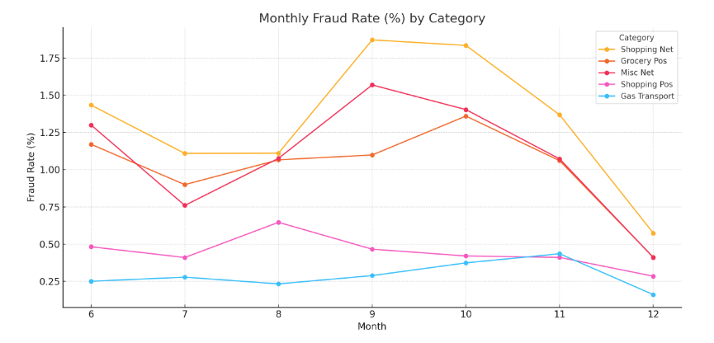
Can We Identify Fraudulent Patterns Across Merchant Categories?
Shopping Net & Misc Net
Top fraud-prone categories due high transaction volumes from online marketplaces.
Fraudsters exploit promotional periods to hide activity.
Grocery POS & Gas Transport
Routine, low-value purchases may allow fraudulent transactions to go unnoticed longer.
Shopping POS
Fraud spike in August, likely tied to back-to-school or seasonal promotions.
Notes:
The slight bumps in October for Grocery POS and Gas Transport could be due to a few plausible factors:
Increased spending due to holidays or seasonal changes October often sees a rise in consumer activity ahead of holidays like Halloween and early preparations for end-of-year events. Fraudsters may take advantage of increased transaction volume to hide suspicious activity.
Card testing and low-value fraud attempts These categories are often used for "card testing"—fraudsters make small purchases (like groceries or gas) to verify stolen card details before attempting larger fraud elsewhere.
Less scrutiny on everyday purchases Grocery and gas purchases are routine, so suspicious transactions may go unnoticed longer—making them appealing for fraudsters to exploit subtly.

Slide 7


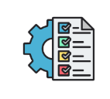



Taking Action to Stop Fraud and Protect Customer Funds
Implement enhanced fraud checks before approving transactions
Use risk-based thresholds for categories like Shopping Net and Misc Net
Require additional verification (e.g., 3DS, OTP) for large or unusual purchases
Know Your Customer policy - Identify high-risk users

Slide 8

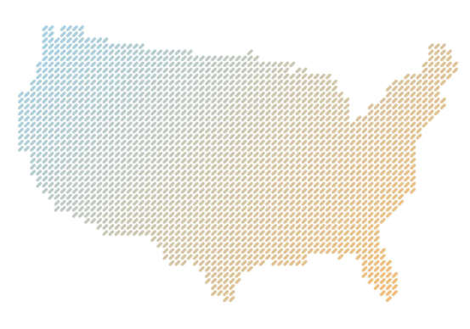
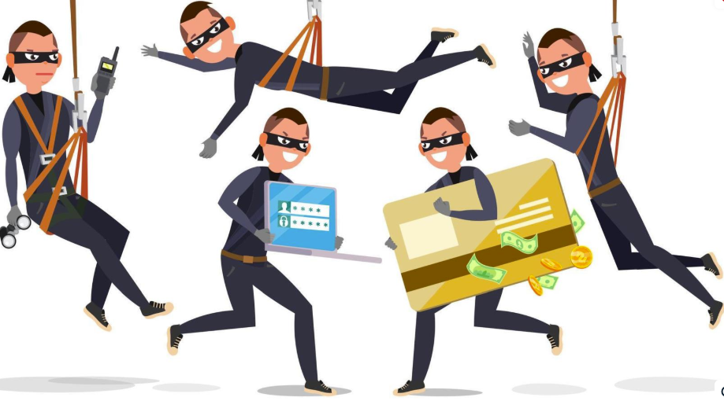
Understanding Customer Risk Profiles and Fraud Exposure
Fraudulent transactions per Geo Location – Cities with Fraude_Rate>=2%
Would you consider the cities with 100% fraud_rate as high Risk?
Notes:
We can explore if it’s a trend or not for these cities using more characteristics of these customers

Slide 9









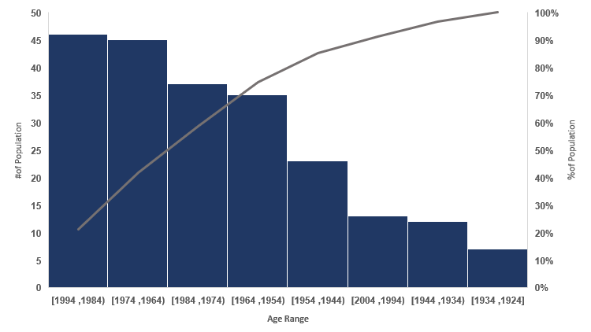
Understanding Customer Risk Profiles and Fraud Exposure
Fraud Transactions Across Age Groups
Certain age groups (e.g., 18–25 or 60+) having higher fraud rates
Mismatched behavior - like very high-value transactions from users under 20
How to mitigate Risks? Require additional authentication for high-risk age groups
Combine age with other risk signals:
Location
Transaction Amount
Transaction Frequency
Device ID
Known Merchant? High Risk Category?

Slide 10

Key Insights to Strengthen Fraud Detection
Merchant Category Risk
Closely monitor high-risk merchant categories such as Shopping_net and Misc_net. Due to high transaction volumes and weak verification controls they are frequent fraud targets.
Customer Behavior Patterns
Identify abnormal behavior: frequency, value, timing.
Develop profile segmentation for customers (e.g., age, tenure, typical spend)
Combine with age, category, and device to detect ATO.
Location Intelligence
Unusual geolocation or high-risk regions can signal ATO.

Slide 11
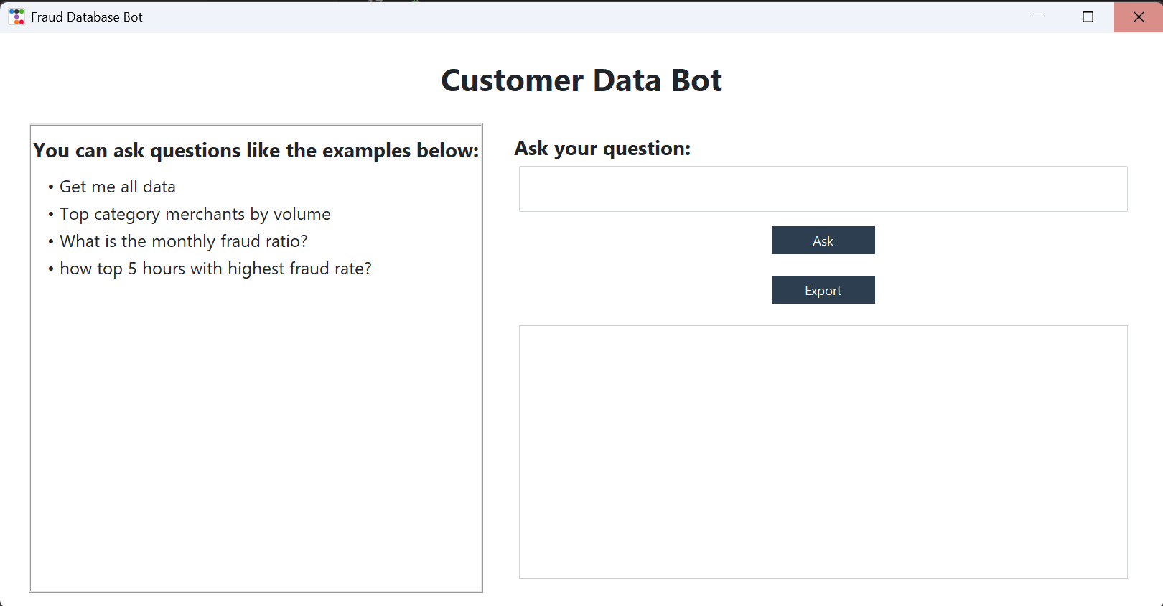
NLP Bot
🤖 NLP Bot for Fraud Data Exploration
The NLP Bot helps users explore fraud data through a simple Python app using short, natural-language questions. Each answer can be instantly exported for reporting or further analysis.
It is trained to understand and respond to 4 main types of queries and can detect question intent accordingly.
The 4 key types of queries:
Get me all data.
Top category merchants by volume.
What is the monthly fraud ratio.
top 5 hours with highest fraud rate.
Additionally, all retrieved data can be exported as .xlsx or .csv files for further use.

Slide 12
Thank You!

